Slide 1
MAAS
Match, Attach, and Sustain:
New Methods for Europe’s Job Brokers
supporting Tourism businesses, Ukrainian refugees and job seekers
Funded by the European Union. Views and opinions expressed are however those of the author(s) only and do not necessarily reflect those of the European Union or the European Education and Culture Executive Agency (EACEA). Neither the European Union nor EACEA can be held responsible for them. 2023-1-SE01-KA220-VET-000159421

Slide 2
WELCOME TO THE MAAS COMMUNITY OF PRACTICE
Workshop #6
“Swedish integration programs for refugees and Jobseekers”
Projects for Ukrainian refugees in Sweden

Slide 3
Background
When many Ukrainian refugees came to Sweden the Swedish civil society took a significant responsibility from the start
Folkuniversitetet started courses in Swedish early on to help Ukrainian refugees to integrate in Sweden (Swedish municipalities did not receive state funding to offer Swedish for immigrants for Ukrainian refugees before July 2023)
When the European Social Fund opened calls for projects to support the integration and labour market inclusion of Ukrainian refugees Folkuniversitetet applied for funding to be able to give further support in their integration

Slide 4
Folkuniversitetet has run three different projects for Ukrainian refugees, funded by the European Social Fund:
Oct 2022 – Sept 2023
- “Work for Ukrainians”
Oct 2023 – March 2024
- “Work for Ukrainians Individual”
April 2023 – Sept 2023
- “Care – for Health Care”

Slide 5
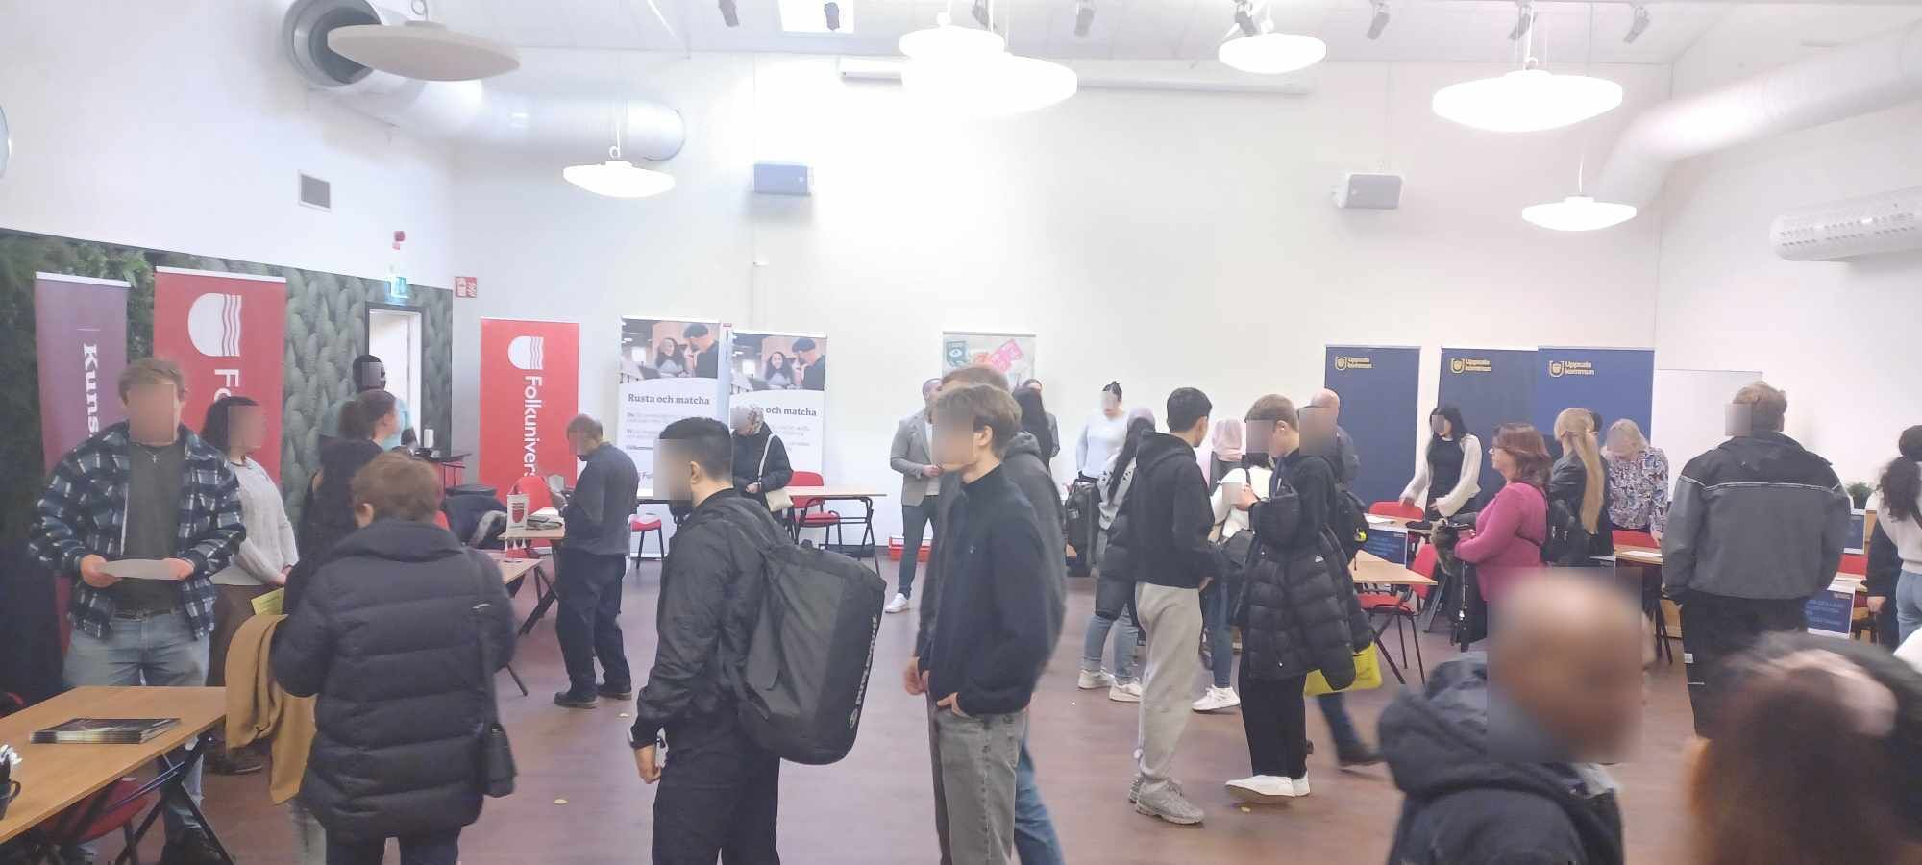
Main Purpose
Self-sufficiency and inclusion for women and men aged 18 and over, who are covered by the EU's mass displacement directive as a result of the war in Ukraine, and who are in Sweden and judged to be in need of efforts to come to work and become socially involved.

Slide 6
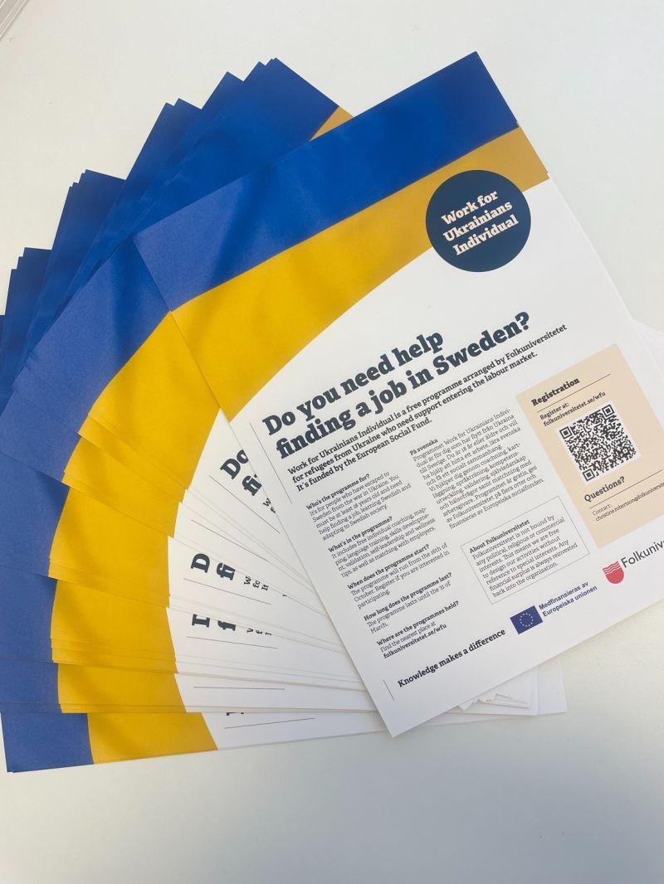
“Work for Ukrainians” and “Work for Ukrainians Individual”
The projects were run in five different counties
One lead project manager and five local project managers
Local project teams of guides/coaches, teachers and language support providers
More than 750 Ukrainians participated in the projects

Slide 7
Methodology of the projects
Swedish courses – an important foundation for establishment in the Swedish labour market.
Social and cultural activities to promote social participation in society and wellbeing
APR
Customised employment counselling and mentoring
Health promotion activities
Competence development
Internship

Slide 8
Professional and general competence development
Labour market adapted diploma courses
Lectures for community-oriented purposes
*Example: Entrepreneurship / how to start a business.

Slide 9
Health Promotion
Agreement with local gyms where time was set aside for participants in the project to train.
General health promotion approach in individual conversations and group activities.

Slide 10
Matching process
Support with individually adapted support with employer contacts
Career mapping process
Career guidance
Internship procurement as a step on the way to employment

Slide 11
Challenges and Solutions
Language barriers
Recession / Poor labour market

Slide 12
Results of the Project “Work for Ukranians”
🔴 38 percent of the participants found work, of which 24 percent were full-time.
🔴 24 percent went on to education.
🔴 Overall, 62 percent of participants achieved the goal of work or education.
🔴 In the latest participant survey, 75% answered that they had increased their network of social contacts thanks to the project

Slide 13
Results of the Project
“Work for Ukrainians Individual”
🔴 Indicator of work: 40 percent.
🔴 Indicator for studies: 5 percent.
🔴 Progress towards the labor market: 93 percent.
🔴 Horizontal principles: 85 percent.
🔴 General skills development: 61 percent.

Slide 14
Success case
Ganna has a master's degree in international economics and has worked for about 20 years in accounting and business development in Ukraine.
Since its inception, Ganna has been open for practice and commuting. Supervisors and participants have worked strategically together and mapped the labor market in general, her career field specifically, and then targeted actors.
The supervisor finally got in touch with a financial manager at Knivsta municipality who opened up an internship, with the possibility of a temporary position during the summer.
Ganna was employed as a financial assistant on May 17, 2024.
- I am so grateful for the help I received in the project, says Ganna. My supervisor really took the time to go over my background, experiences, skills, and goals and helped me get an internship that matched my experiences and goals.

Slide 15
Methodology of the project “Care for Health Care”
Intense Swedish courses for Ukrainian refugees with professions that require professional licensing.
Most of the 66 participants had better progress during the project's short duration than what is expected for academics studying Swedish for immigrants in a year
APR
A certain level of Swedish (C1) is needed to be able to apply for a Swedish medical license, nursing license or similar license.
Teaching was mainly online to make it possible for more participants to attend
The project aimed to speed the participant’s process to be able to work within the Swedish health care.
Small teaching groups
(5-10 participants in each group)

Slide 16
Results of the Project “Care for Health Care”
🔴 40 percent of the participants had knowledge corresponding to level B1
🔴 31 percent had knowledge corresponding to level B2
🔴 8 percent of the participants had knowledge corresponding to level C1

Slide 17
Reflections on the implementation
The importance of individually customised support
The importance of flexibility in the project implementation when participants have very different conditions for participation
The importance of networks and good connections with employers
Short periods of internship as a good way to show one’s competence
The importance of a qualified career counsellor in the project team
The importance of cooperation with local associations and working with issues of social networks
The engagement of the project staff is a key factor in creating trust with the target group and achieving results

Slide 18
Reflections on the implementation
In the latest of the projects, Work for Ukrainians Individual, we were inspired in our methodology by the large-scale Danish progression study called BIP (Beskæftigelses Indikator Projektet, in English: the Employment Indicator Project).
The conclusion of that research states that you will have a better progression by working with coordinated parallel efforts in several fields compared to working with a more traditional step-by-step model.
We can see that having a holistic view of the participants and offering health promotion activities, social and cultural activities as well as support in different everyday issues, alongside competence development and job-focused activities, contributes to creating favourable conditions for the establishment in the labour market.

Slide 19
Question and answer session
01 - TEXT
03 - TEXT
If you have any questions, please contact me:
robin.stahlberg-ozturk@folkuniversitetet.se

Slide 20
THANK YOU

