Slide 1





MAAS
Match, Attach and Sustain:
New methods for Europe’s Job Brokers
supporting Tourism businesses, Ukrainian refugees and job seekers
Funded by the European Union. Views and opinions expressed are however those of the author(s) only and do not necessarily reflect those of the European Union or the European Education and Culture Executive Agency (EACEA). Neither the European Union nor EACEA can be held responsible for them. 2023-1-SE01-KA220-VET-000159421

Slide 2


WELCOME TO THE MAAS COMMUNITY OF PRACTICE
Workshop #6
“Swedish integration programs for refugees and Jobseekers”
Program ”Rusta och Matcha”

Slide 3
What is “Rusta och Matcha”
It is a project commissioned by the employment agency.
We help unemployed people into work or education on behalf of the employment agency. It is a project that they direct, and the participants are referred through them.
The employment agency and its tools control everything we do with the participants.
The project lasts 6 months and a maximum of 1 year
For the unemployed who are far from the labour market

Slide 4
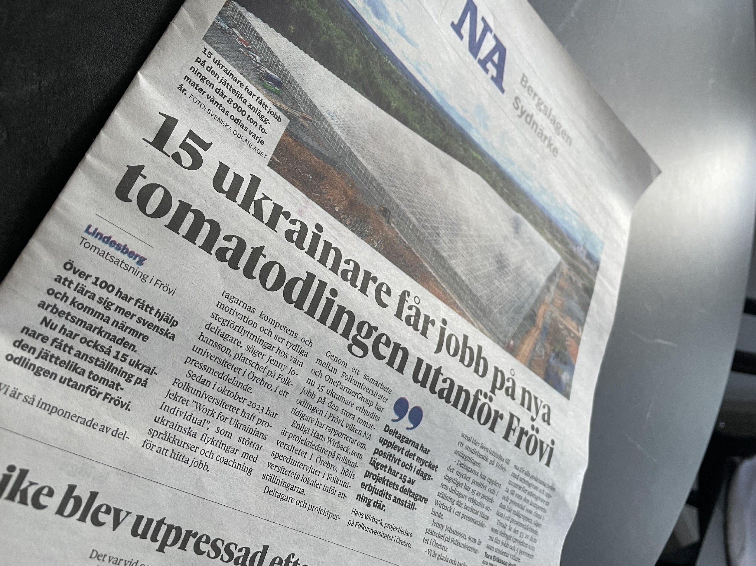
The goal of the project is to get participants into jobs or education.
Our personal goal is to get 4 people to work every month.
Statistics are shown to participants, and then they can make easier decisions. They then see who has the best results in getting people into work.

Slide 5
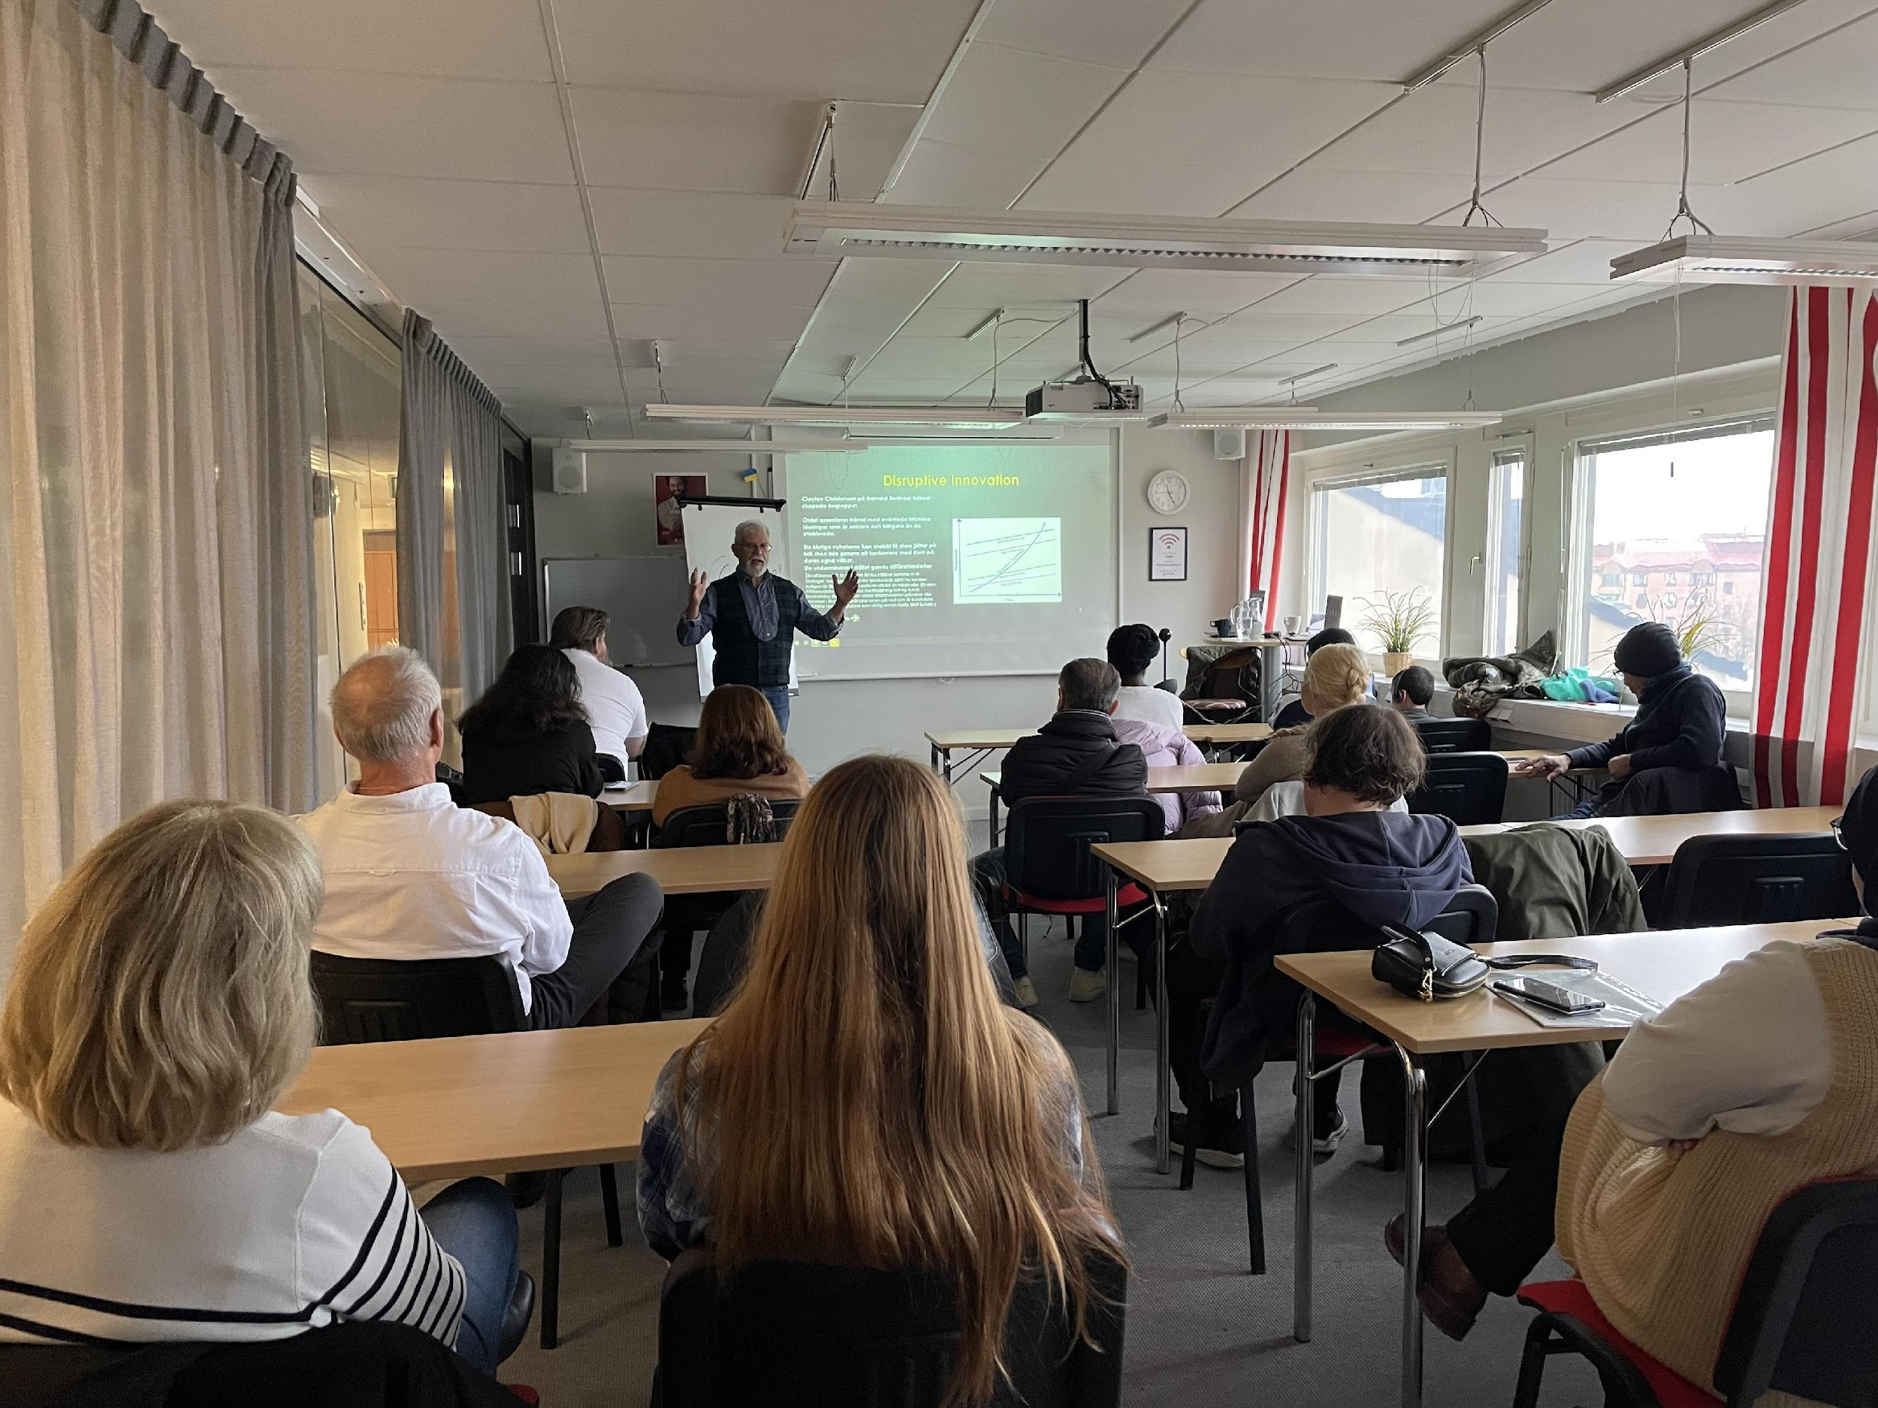
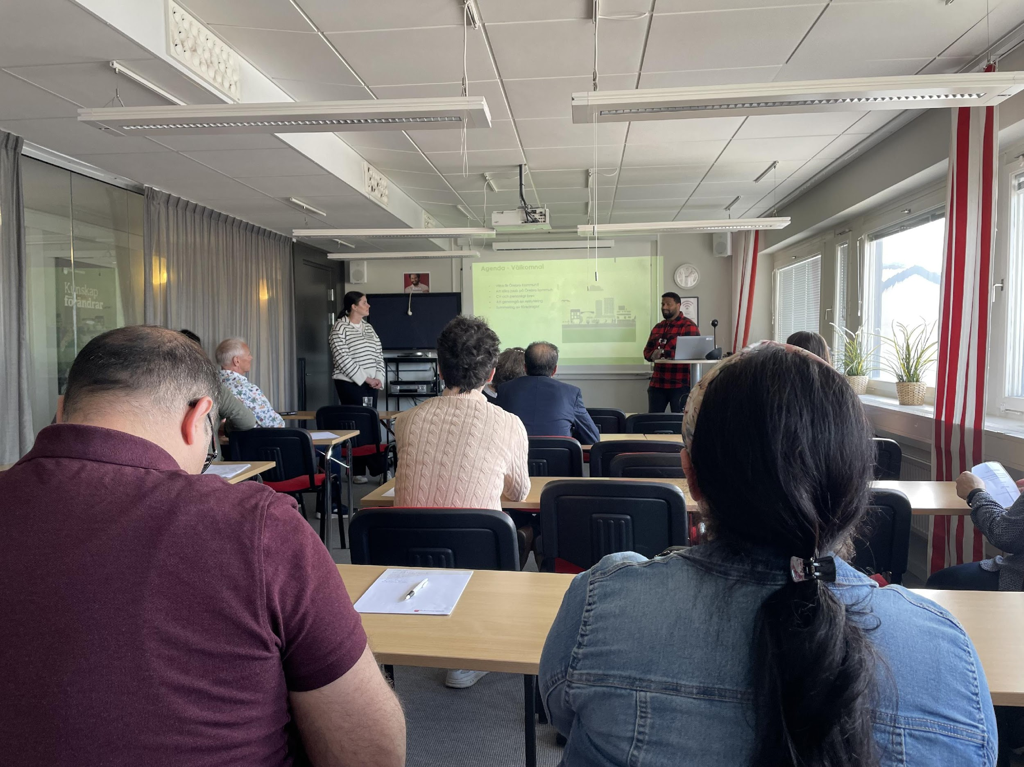
Tools
Their approved tools can be:
to get help with your CV and cover letter
to get help with easier tasks in the Swedish language
to contact employers
to practice interviews
to receive information about the labor market
to get support with computer skills

Slide 6
The employment agency requires documentation of:
Attendance report
Record activities
Absence report
Adapted premises
Schedule of activities
Adapted material such as adjustable desk, computer, printer, adapted office chair
The toilets must be adapted for the disabled and marked for the visually weakened

Slide 7
Challenges and Solutions
Challenges:
The employment agency does not make decisions for “Rusta och Matcha” as quickly and often as we would like. It then makes a gap.
The participants are enrolled in other projects such as “Korta Vägen”, Career Guidance, Steps to Work (Steg till arbete), and other initiatives.
Solutions:
Marketing
More information to the participants
Just patience
Equip the participants we have for better results – better ratings in the end
01 - TEXT
03 - TEXT

Slide 8
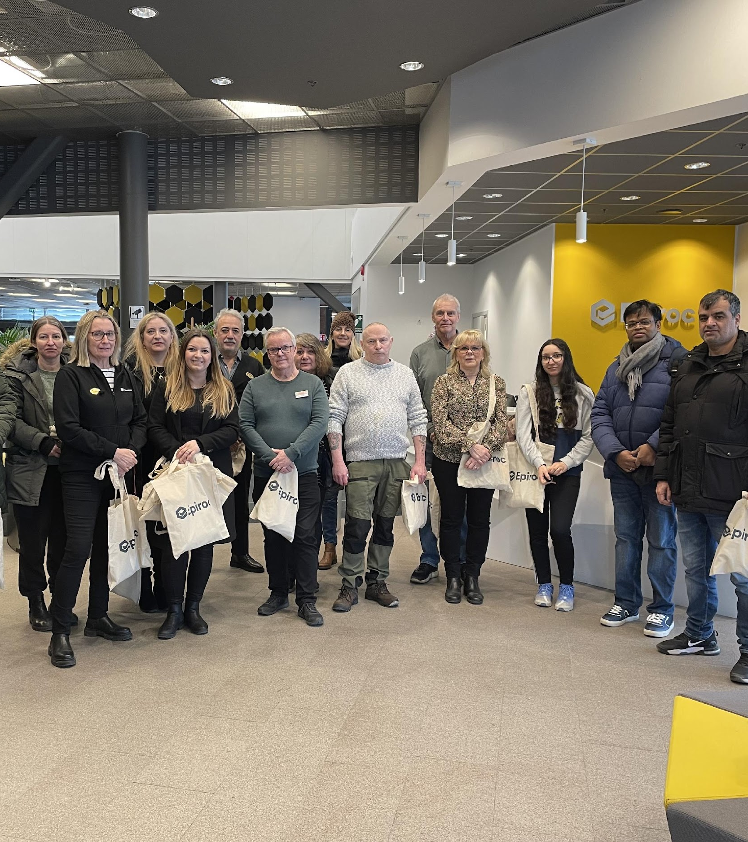
What does Folkuniversitetet do?
Invites companies that give lectures and do speed interviews
Work with own material such as the self-coaching program
Digital online courses from Jobbmatchad.se
Workshops
Collaborates between offices with different materials and lectures
Easier language teaching
Easier teaching of computer skills
Company visits
Notes:
All this is done to equip our participants for the job market

Slide 9
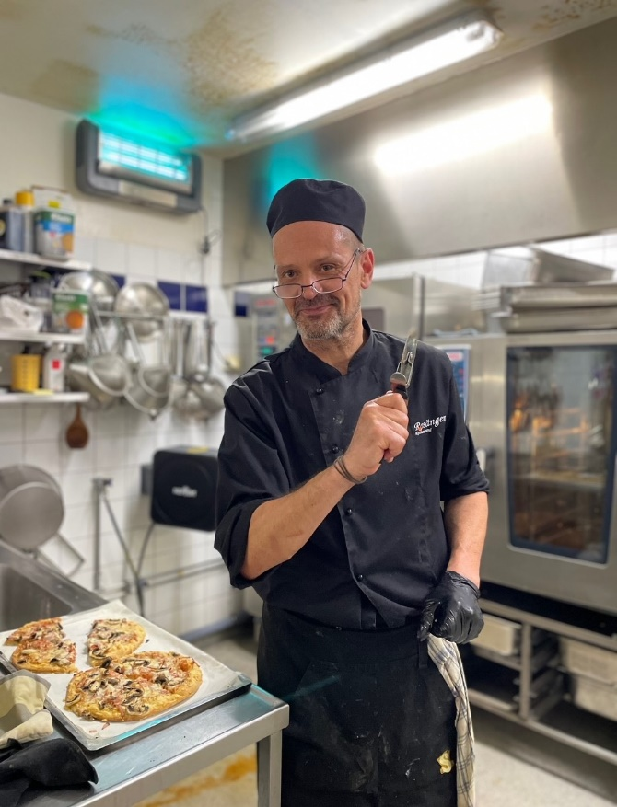
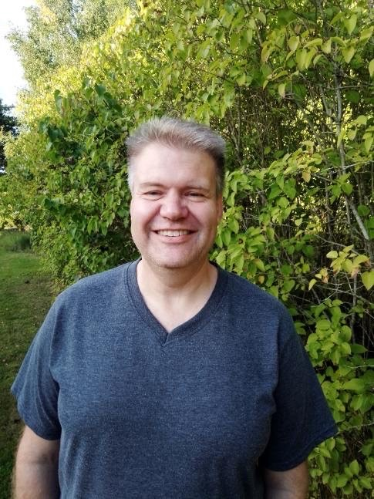
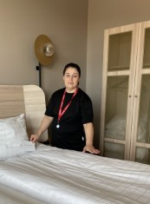
Impact and success stories:
"Folkuniversitetet, a place for everyone! They see who you are, prepare and match you for the future with the whole in focus." Magnus Andersson.
"I have been unemployed for a very long time, thanks to the Folkuniversitetet that helped me find the job at Scandic Hotel, which I am very happy with." Vecihe Yildaz
"Happy and grateful for all the support from Folkuniversitetet. Through their network, I got a job that I really enjoy!” Göran Hammar.
Notes:
Jobbmatchad.se hemsida

Slide 11
The participants are satisfied and feel seen
We make the right matches to make it as sustainable as possible for participants and the employer
Satisfied employers
With the right match, there is a good and stable contact network

Slide 12
Future directions and potential for expansion
To open more offices in more locations to get an increased number of participants in the market
Even more marketing to get the rating
Skills development staff so we are always up-to-date

Slide 13
Summary and key points
Good results
Rewarding project
Good cooperation
Good contact network - valuable for us and the participant
Competent and experienced coaches
Good tools to offer participants that bring them closer to the labor market

Slide 14
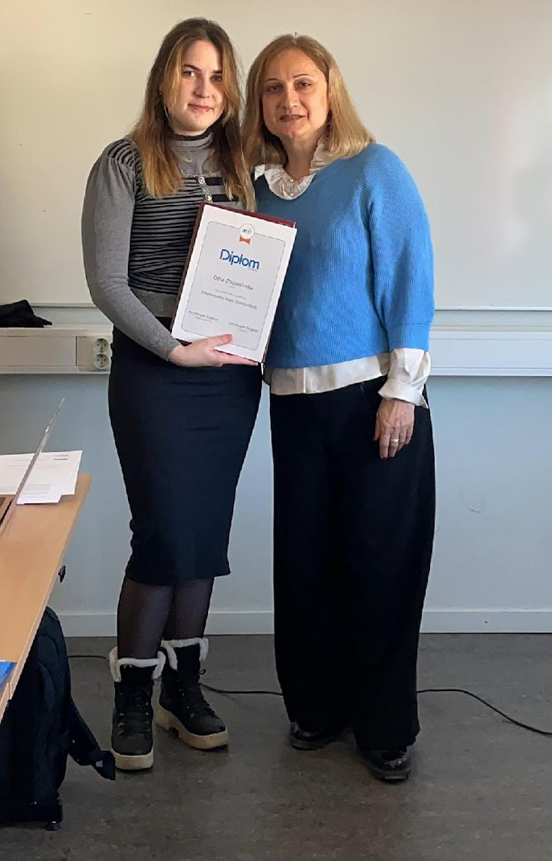
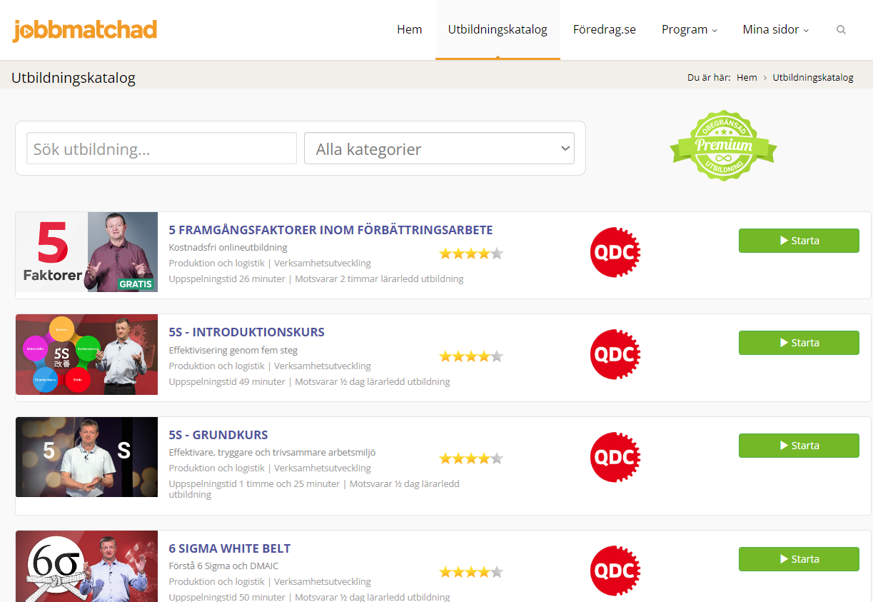
Jobbmatchad.se
"In Jobmatchad there is something for everyone, regardless of what professional direction you have or have planned. There you can also get inspiration for something completely new, i.e. a profession you never even thought about.
Many good courses with committed lecturers/teachers where you get a diploma after completing the course. Good to add to your CV.”
approved activity from the employment agency
hundreds of courses and lectures in various industry specializations
you get a diploma after each completed course
there are subtitles in English, Swedish and Ukrainian, Arabic is in progress
more attractive on the labor market
Notes:
Jobbmatchad.se hemsida

Slide 15

Question and answer session
01 - TEXT
03 - TEXT
If you have any questions - kindly ask you to contact me: Almedina.tatarevic@folkuniversitetet.se

Slide 16
THANK YOU!

