Slide 1



ACCESS TO LABOUR MARKETS AND EMPLOYMENT IN EUROPE FOR
UKRAINIAN REFUGEES

Slide 2
01
03
02
04
Key Points
Refugees from Ukraine: some Statistical Indicators
Acces to Labour Market:
EU Facilitating Steps
Ukrainian Refugees Profile
Challenges Faced by Ukrainian Refugees in Employment

Slide 3



Informational Resources
UNHCR operational data portal
https://data.unhcr.org/
The International Organization for Migration
https://www.iom.int/data-and-research
Migration Policy Institute
https://www.migrationpolicy.org/
EUROPE
Centre for Economic Strategy
https://ces.org.ua/en//

Slide 4
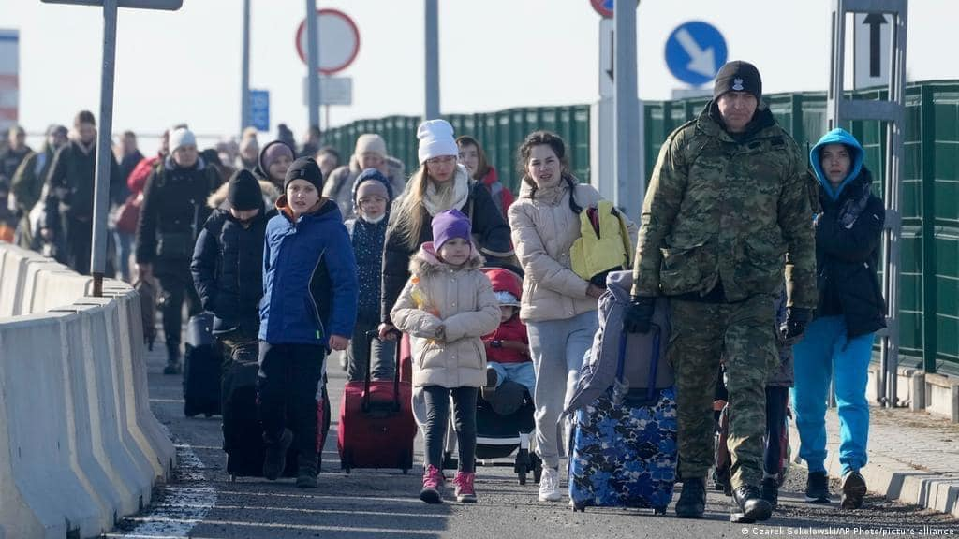
01
REFUGEES FROM UKRAINE:
PUTTING THE NUMBERS IN PERSPECTIVE

Slide 5
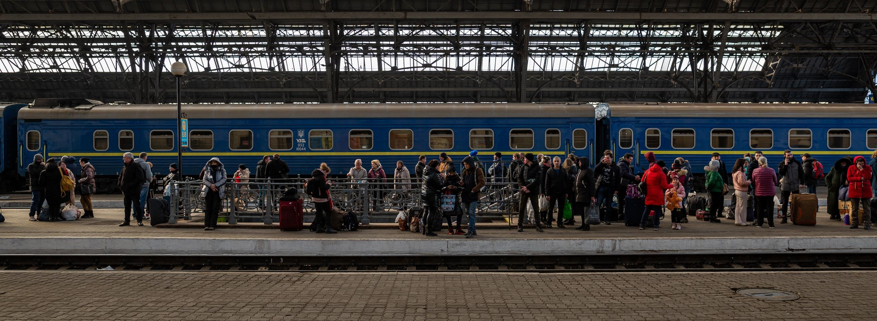
PEOPLE FORCED TO FLEE
5,982,900
Refugees from Ukraine recorded in Europe
(as of Mar 2024)
503,100
Refugees from Ukraine recorded beyond Europe (as of Mar 2024)
6,486,000
Refugees from Ukraine recorded globally
(as of Mar 2024)
More details: UNHCR Operational Data Portal Ukraine Refugee Situation

Slide 6

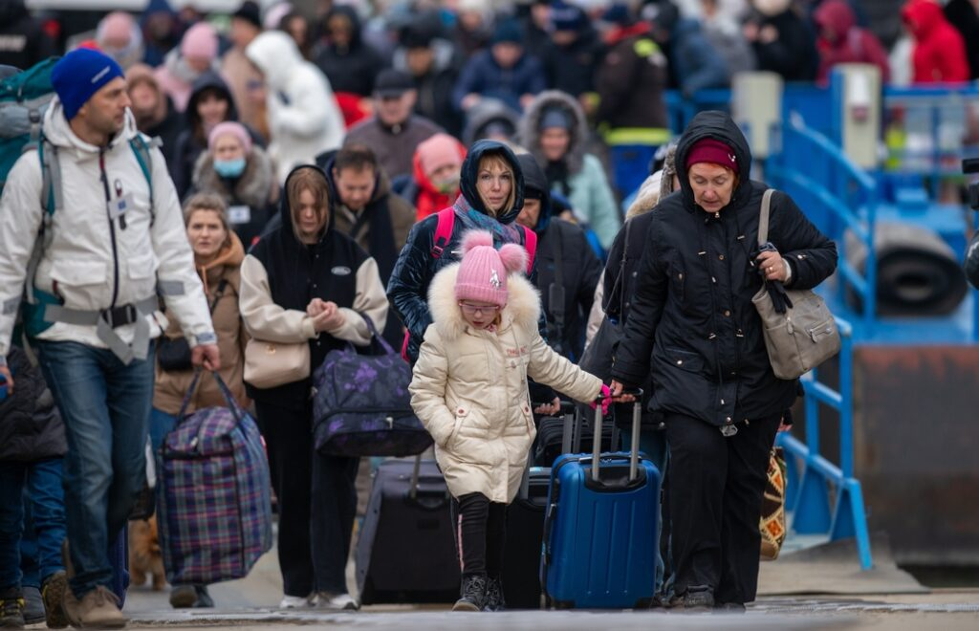
5,982,900

Slide 7
The distribution of refugees has changed significantly over the past year
4 500
4 000
3 500
984
1
140
1
167
1
148
1
171
1
197
1
024
1
071
1
110
3 000
2 500
2 000
1 500
961
974
994
1
000
995
991
1
371
1
017
944
1 000
500
814
874
932
968
1
005
1
035
1
068
1
090
1
112
0
2022-09
2022-10
2022-11
2022-12
2023-01
2023-02
2023-03
2023-04
2023-05
Germany
Poland
Czechia
Spain
Italy
Bulgaria
Others
Source: European
Service of Statistics
6

Slide 8



Which EU countries do Ukrainian refugees choose?
Germany
Poland
Czech Republic
Estonia, Spain, Italy, Bulgaria
1,235,960
955,110
369,330
28,9%
Germany
22,3%
Poland
8,6%
Czech Republic

Slide 9
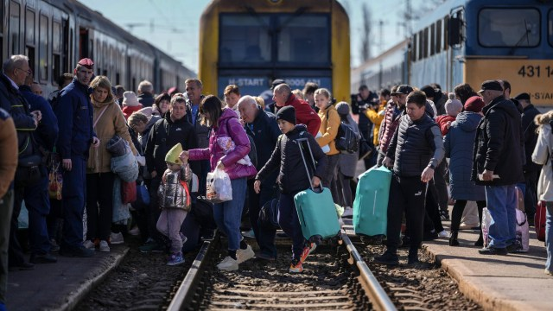
02
UKRAINIAN REFUGEES PROFILE

Slide 10
Demographic structure of Ukrainian refugees
65+
years old
6
2
2
%
4
%
thousand
168
thousand
35-64
347
9
%
26
%
995
18-34
262
7
%
17
%
637
14-17
153
4
%
4
%
142
0-13
years old
526
thousand
14
%
13
%
512
thousand
Men
Women
Source: Euro
stat
19

Slide 11
Language skills
Level of Education
THE UKRAINIAN REFUGEE’S PROFILE ON THE EU LABOUR MARKET
Digital Skills
Data from investigation conducted by the European Union Agency for Asylum (EUAA) and the Organization for Economic Co-operation and Development (OECD) across a few EU states
77% have a work or business background
Work experience
Refugees often demonstrate a high level of proficiency in the English language. A small share of refugees speaks other languages
71% of Ukrainian refugees indicate to have a university education, with the majority being holders of a Master’s degree
Varied Levels of Digital Literacy

Slide 12
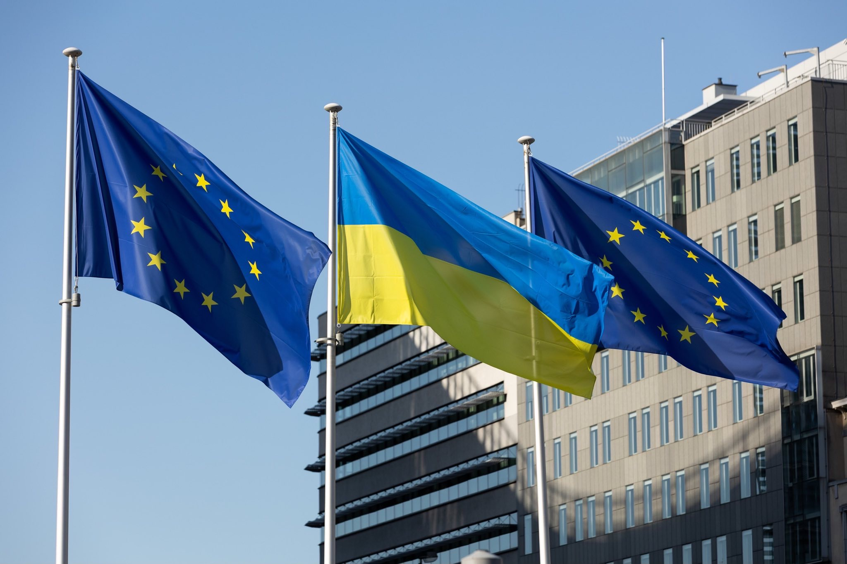
03
STEPS TAKEN BY EU COUNTRIES TO FACILITATE THE ACCESS OF UKRAINIAN REFUGEES TO THE LABOUR MARKET

Slide 13
STEPS THE EU COUNTRIES TAKING TO FACILITATE UKRAINIAN CITIZENS ENTERING THE EUROPEAN UNION’S LABOUR MARKET
Legal framework
Measures implemented by European countries to facilitate Ukrainian refugee’s employment
Fast track procedures
Language training
Skills assessment and matching
Financial incentives for employers
Entrepreneurial Support
Temporary Protection Directive
(4 March 2022)
EU Talent Pool

Slide 14
Ukrainians in Europe: how many refugees have found work abroad
Denmark
78%
Czech Republic
66%
Although Ukrainian refugees have the right to work in all EU countries, there are differences in social assistance systems.
Poland
65%
Sweden
56%
Great Britain
50%
Germany
26%

Slide 15
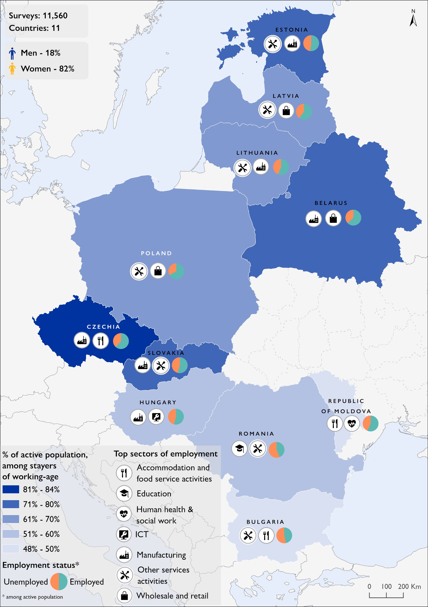
What kinds of jobs do they hold?
Displaced Ukrainians have tended to find jobs that require fewer formal qualifications and/or little host country language proficiency.
For example, data from the Netherlands suggest that Ukrainians there are finding work primarily in the hospitality, agriculture and horticulture, logistics, and services industries.
Around half have found temporary employment through agencies, for example as cleaners or warehouse employees.
ACCESS TO LABOUR MARKETS AND EMPLOYMENT IN EUROPE

Slide 16

04
CHALLENGES OF INTEGRATING INTO THE LABOUR MARKET FOR UKRAINIAN REFUGEES

Slide 17



Challenges faced by the refugees
Eligibility
Language
Accomodation
If you do not speak the language of the host country or English, your employment opportunities will be limited
Governments locate transit and refugee camps in areas where job opportunities are extremely limited
Without registering with the governments of host nations, refugees cannot legally take up employment.
Formal refugee status allows externally displaced Ukrainians to work only in the country where they've registered.

Slide 18



Challenges faced by the refugees
Childcare
Uncertainty
Expectations
Because many Ukrainian refugees are mothers with young and school-age children, they can only go to work if some form of child daycare is available
Most Ukrainian refugees are perceived to be looking for short-term or temporary employment because most hope to return home eventually
Mismatching between the demand for and the supply of jobs

Slide 19
THANK YOU
Feel free to ask questions

